Slide 1
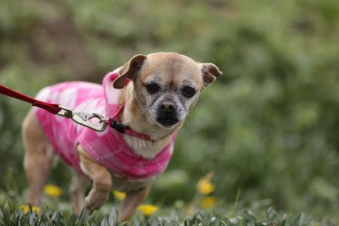
Helping Shelter Animals

Slide 2
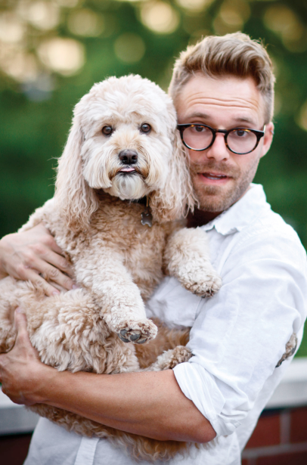
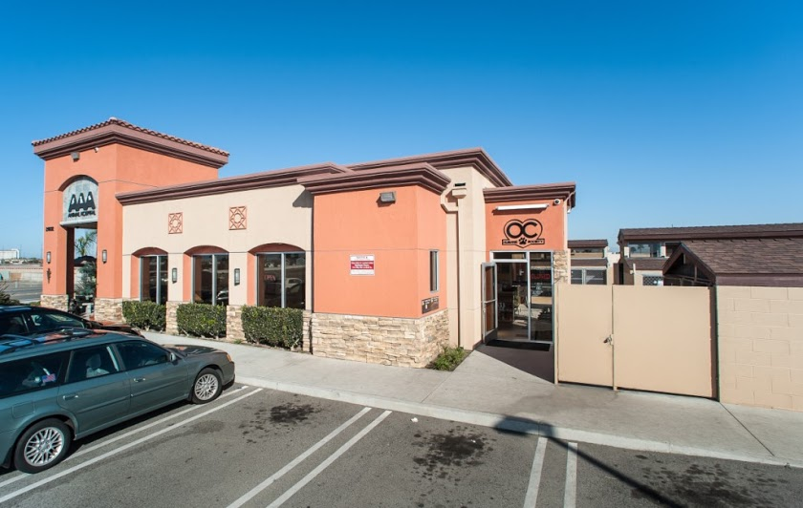
How I Started
Idea from Seth Casteel (charity called One Picture Saves a Life)
Summer of 2013
Emailed seven shelters – only accepted by OC Humane Society
Took photos of cats and dogs for website

Slide 3
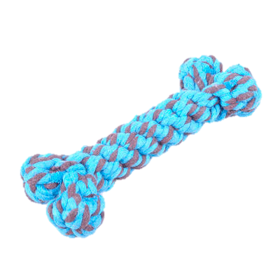
Obstacles
Getting accepted at a shelter
  First try: asked shelter in person
  Second try: through emails
Getting pets’ attention
  Food, sounds, toys
Time + organization
  Took too long per visit, could only help one shelter

Slide 4

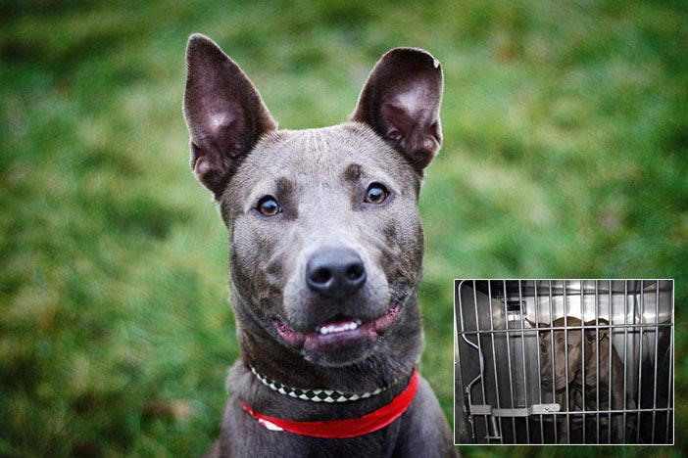
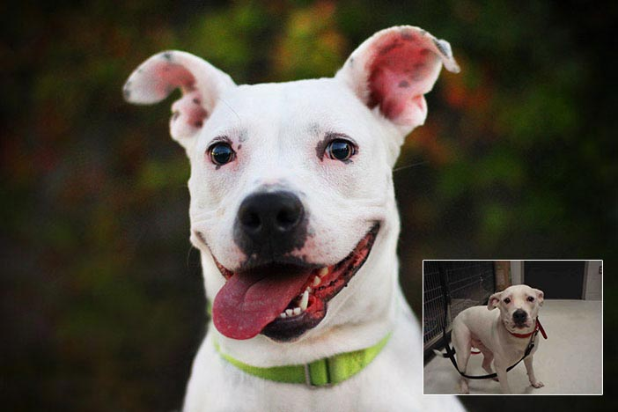
Seth’s Workshop
Learned how to approach pets, take good photos
  Stay ~six feet away
  Use food/toys to get attention
  Take pictures outside
tours country to take photos at many shelters
Goal: portray pets as cheerful, not sad/behind a cage

Slide 5


More Tips
Dogs
  Burst mode on camera
  Surprises/noises only work once – get picture during moment
  Low aperture number for blurred background (if camera has manual control)
  Fast shutter speed freezes action
Cats
  Usually indoors (light bulb + umbrella = good lighting)
  Usually respond to toys

Slide 6
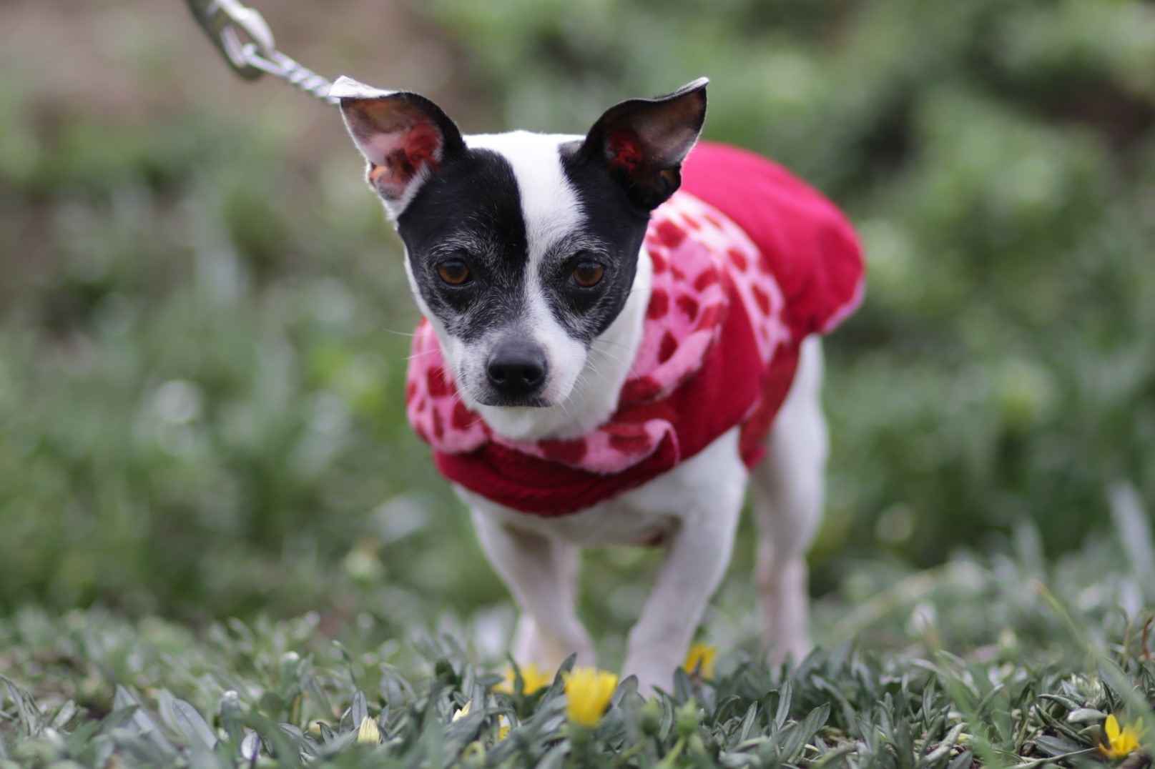

Slide 7
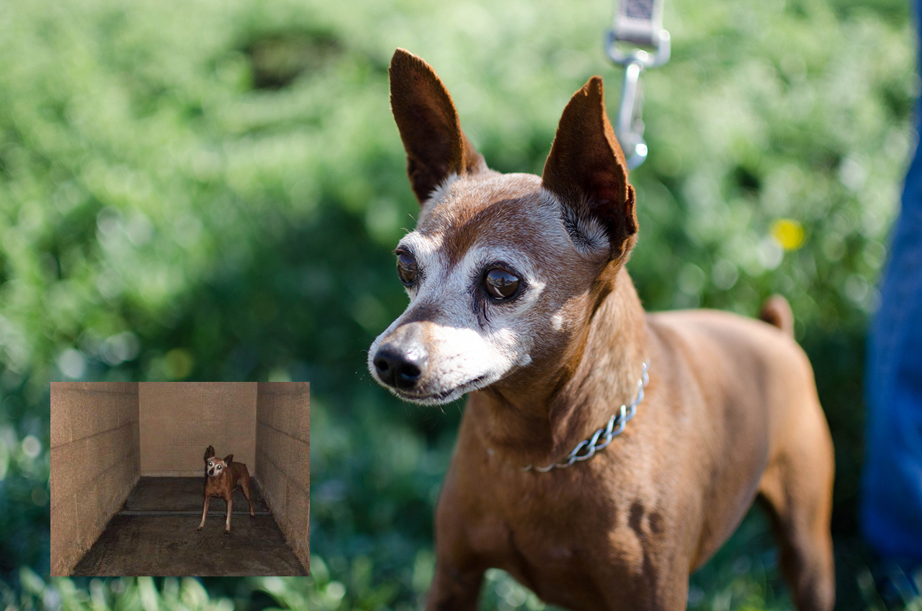

Slide 8
What I Learned
How to approach shelters / confidence
Photography techniques
Problems shelters face
Interacting with animals

Slide 9
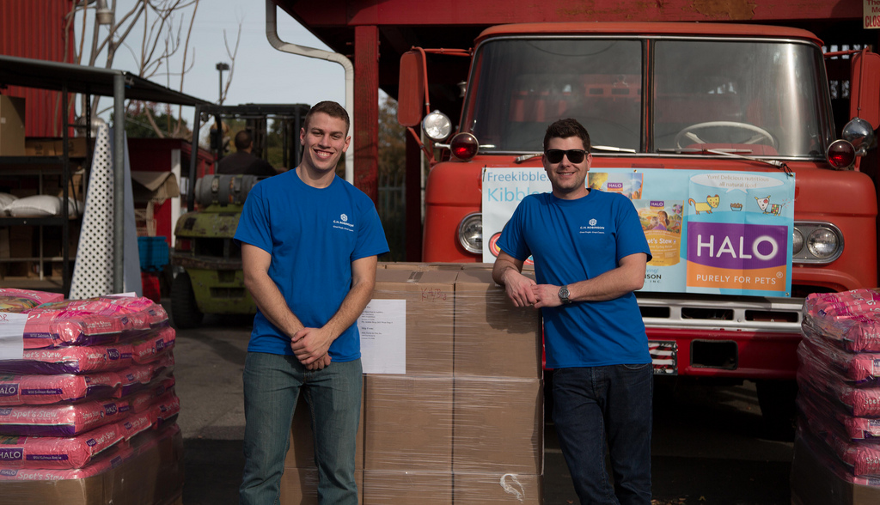
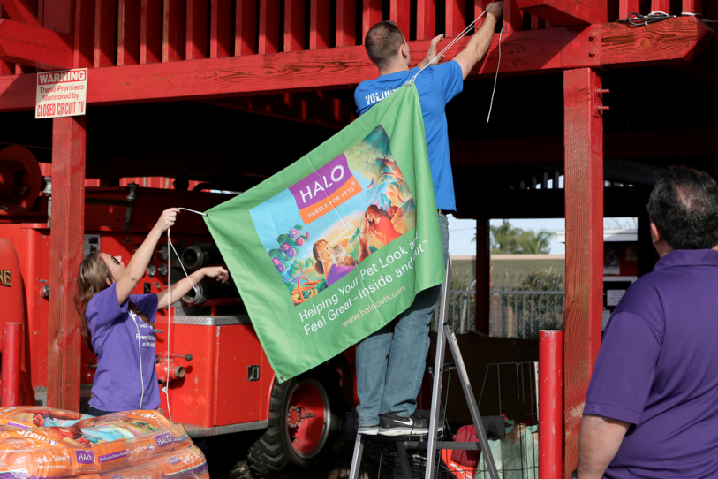
Further Contributions
Shelter Me Video Contest – won $1500 for the shelter
Kibble Drop – shelter received 5000 meals

Slide 10
Future Goals
Expand to more shelters in Orange County
Create a club for others who are interested
Continue to look for opportunities to earn money/supplies for shelters

